Slide 1
Azure App Registration Secret Rotation Script
Automating secure credential updates for cloud applications
Notes:
AI-generated content may be incorrect. ---

Slide 2
Introduction
Notes:
Overview of the Script

Slide 3

Overview of the Script
Secret and Certificate Rotation
The script automates secure rotation of secrets and certificates for Azure Active Directory App Registrations.
Secure Storage and Access Management
Expired credentials are securely stored in Azure Key Vault with managed identity managing access policies.
Network and Policy Configuration
The script manages network firewall rules and access policies to enable secure secret management.
Error Handling and Logging
Robust error handling and logging ensure operational efficiency and security monitoring.
Notes:
This presentation provides a walkthrough of a PowerShell script designed to automate the rotation of secrets and certificates for Azure Active Directory App Registrations. The script ensures that expired credentials are replaced securely and stored in Azure Key Vault. It also manages network firewall rules and access policies to facilitate secret management via managed identity. The script is intended for use in environments such as Azure Automation or virtual machines with system-assigned identities. It includes robust error handling, logging, and credential lifecycle management features to maintain security and operational efficiency.

Slide 4
Prerequisites
Notes:
Required Modules and Permissions

Slide 5
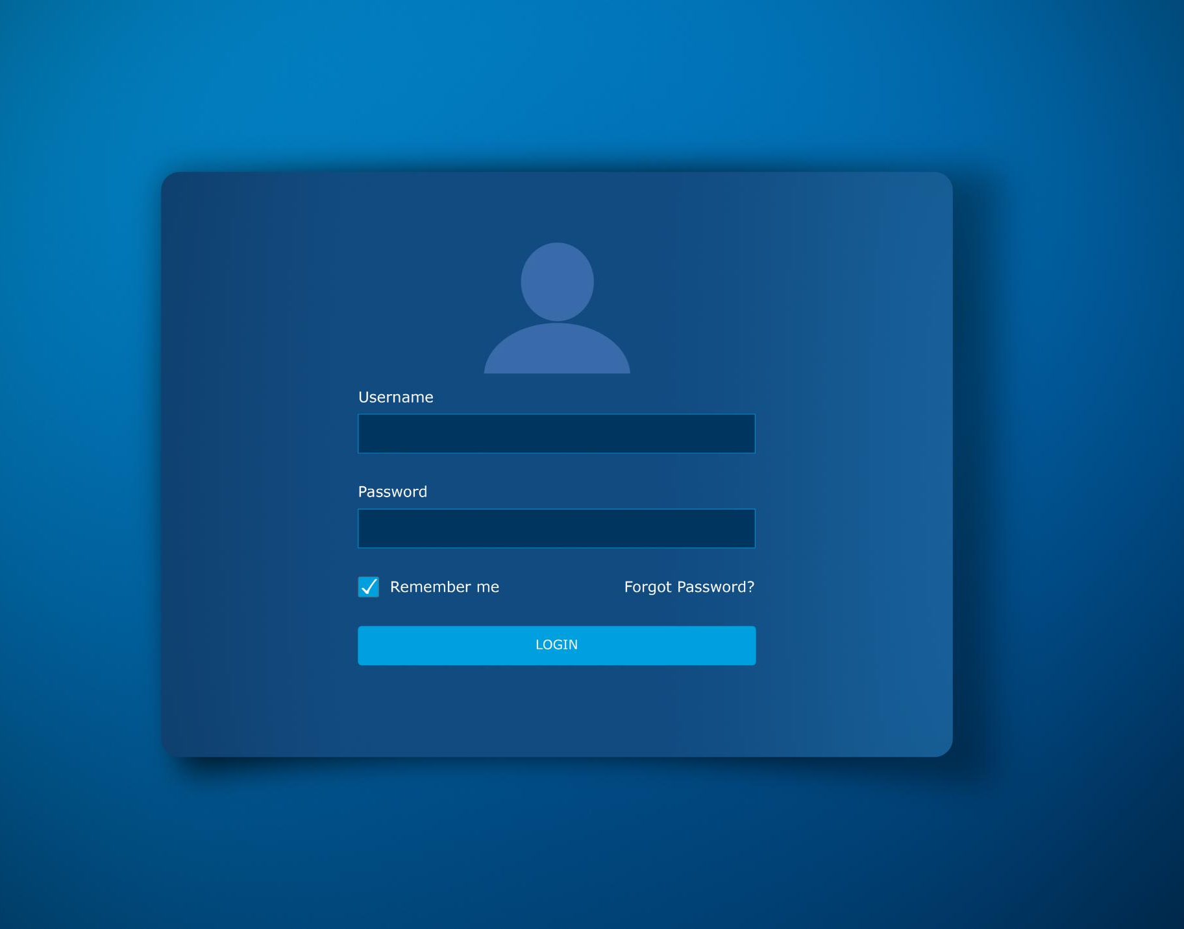
Required Modules and Permissions
Module Installation
Install Az and Microsoft.Graph.Applications modules using PowerShell Import-Module commands for script execution.
Managed Identity Requirement
Script uses managed identity for authentication, requiring a system-assigned identity in Azure Automation or VM.
Access and Permissions
Managed identity needs Contributor or Owner subscription access and Key Vault Administrator permissions to manage secrets.
Microsoft Graph API Permissions
Permissions like Application.ReadWrite.All and Directory.ReadWrite.All are required to interact with Microsoft Graph API securely.
Notes:
Before executing the script, several prerequisites must be met. The Az module and Microsoft.Graph.Applications module must be installed using PowerShell commands such as Import-Module -Name Az -Force and Import-Module Microsoft.Graph.Applications -Verbose. The script relies on managed identity for authentication, which means it should be run in a context where a managed identity is available, such as Azure Automation or a VM with a system-assigned identity. Additionally, the managed identity must have Contributor or Owner access to the subscription, Key Vault Administrator or equivalent access to manage secrets, and Microsoft Graph API permissions including Application.ReadWrite.All, AppRoleAssignment.ReadWrite.All, Group.Read.All, Directory.Read.All, and Directory.ReadWrite.All.

Slide 6
Environment Setup
Notes:
Configuration Parameters

Slide 7

Configuration Parameters
Essential Configuration Parameters
Subscription name, Key Vault name, resource group, and App Registration display name are required for the script.
Purpose of Parameters
These parameters help identify and manage Azure resources accurately within the script.
Secure Operations
Proper configuration ensures authentication, resource access, and secure secret rotation and storage.
Notes:
The script requires specific environment configuration parameters to function correctly. These include the subscription name (e.g., 'wolffentpsub'), the Key Vault name (e.g., 'wolffkv'), the resource group (e.g., 'Adminrg'), and the App Registration display name (e.g., 'wolffentpOAI'). These values are used throughout the script to identify and manage the appropriate Azure resources. Proper configuration ensures that the script can authenticate, access necessary resources, and perform secret rotation and storage operations securely and efficiently.

Slide 8
Script Breakdown
Notes:
Functional Components

Slide 9

Functional Components
Script Initialization
The script starts with module imports and authenticates using managed identity for secure access.
Secret Rotation Function
rotate_expired_secrets updates firewall rules, creates new secrets, and stores them securely.
Expired Secret Removal
remove_expired_credential_secrets deletes expired credentials from App Registrations for security.
Expiration Audit and Execution
Audit flags credentials expiring soon and rotation loop processes secret replacement systematically.
Notes:
The script is composed of several functional components. It begins with module imports and authentication using managed identity. It then retrieves the subscription context and connects to Microsoft Graph. The rotate_expired_secrets function handles the rotation of secrets for a given App Registration, including updating Key Vault firewall rules and access policies, creating new secrets, and storing them securely. The remove_expired_credential_secrets function deletes expired secrets from App Registrations. The script also includes a secret expiration audit that flags credentials expiring within 30 days and stores metadata in an expiration list. Finally, the rotation execution loop processes each expired item by calling the appropriate functions to remove and replace credentials.

Slide 10
Key Features
Notes:
Security and Automation Enhancements

Slide 11

Security and Automation Enhancements
Dynamic Network Access Control
The script dynamically updates Key Vault network ACLs with IP addresses to maintain secure access during secret operations.
Error Handling and Reliability
Error handling mechanisms capture IP-related access errors and retry operations to improve script reliability.
Credential Lifecycle Management
Secrets are securely rotated and stored to reduce risks from expired or compromised credentials.
Comprehensive Logging and Traceability
Logging ensures traceability of IP additions and errors, supporting auditing and compliance requirements.
Notes:
The script incorporates several key features to enhance security and automation. It dynamically adds IP addresses to Key Vault network ACLs to ensure access during secret management operations. Error handling mechanisms capture and retry operations when IP-related access errors occur, improving reliability. Credential lifecycle management ensures that secrets are rotated and stored securely, reducing the risk of expired or compromised credentials. Logging capabilities provide traceability for IP additions and errors, supporting audit and compliance requirements. These features collectively contribute to a robust and secure automation solution for managing Azure App Registration credentials.

Slide 12
Demo Results
Notes:
Execution Output Screenshot

Slide 13

Execution Output Screenshot
Secret Expiration Audit
The script audits secret expiration dates, highlighting expired credentials in red and active ones in green for clarity.
Secret Rotation Process
Expired secrets are removed and replaced with new credentials, ensuring continuous security and access management.
Secure Storage in Azure Key Vault
New credentials are securely stored in Azure Key Vault, enhancing security and centralized secret management.
Automation Validation
Output confirms successful script execution and effective automation, providing visual feedback and validation.
Notes:
This screenshot demonstrates the execution of the PowerShell script in a live environment. It shows the audit of secret expiration dates for various App Registrations, highlighting expired credentials in red and active ones in green. The script then proceeds to remove expired secrets and rotate them by creating new credentials and storing them securely in Azure Key Vault. The output confirms successful operations and provides visual feedback on the automation process, validating the script’s functionality and effectiveness.

Slide 14
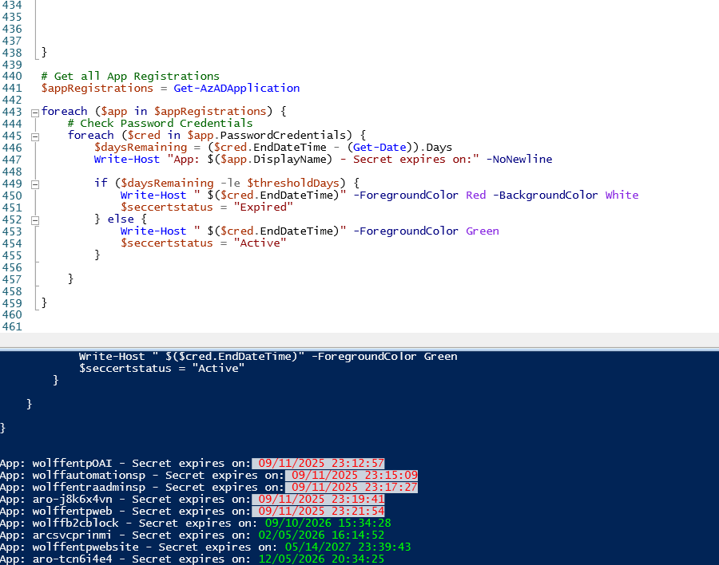

Execution Output Screenshot
Secret Expiration Audit
The script audits secret expiration dates, highlighting expired credentials in red and active ones in green for clarity.
Secret Rotation Process
Expired secrets are removed and replaced with new credentials, ensuring continuous security and access management.
Secure Storage in Azure Key Vault
New credentials are securely stored in Azure Key Vault, enhancing security and centralized secret management.
Automation Validation
Output confirms successful script execution and effective automation, providing visual feedback and validation.
Notes:
This screenshot demonstrates the execution of the PowerShell script in a live environment. It shows the audit of secret expiration dates for various App Registrations, highlighting expired credentials in red and active ones in green. The script then proceeds to remove expired secrets and rotate them by creating new credentials and storing them securely in Azure Key Vault. The output confirms successful operations and provides visual feedback on the automation process, validating the script’s functionality and effectiveness.

Slide 15
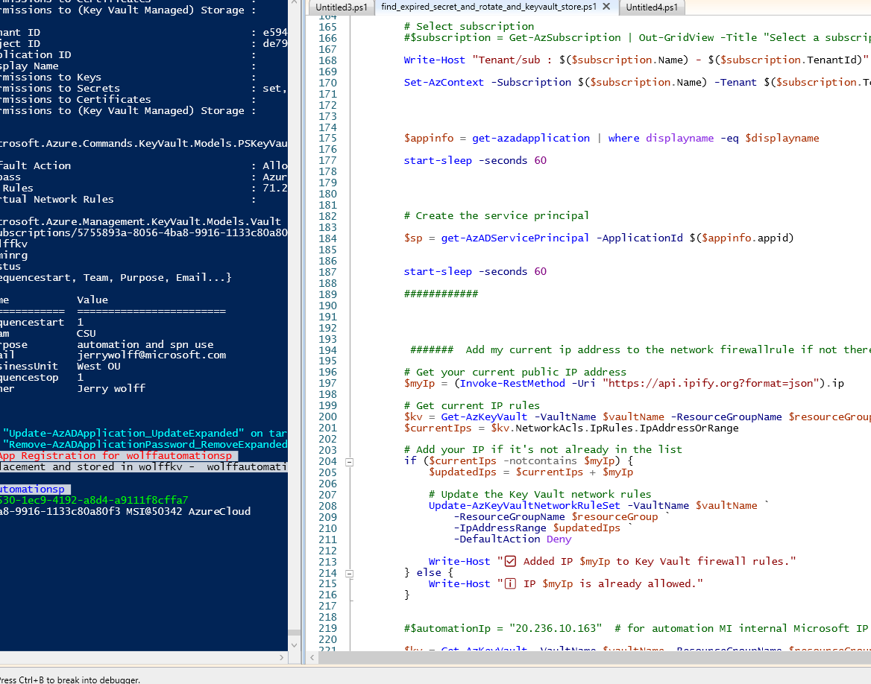
Execution Output Screenshot
Secret Expiration Audit
The script audits secret expiration dates, highlighting expired credentials in red and active ones in green for clarity.
Secret Rotation Process
Expired secrets are removed and replaced with new credentials, ensuring continuous security and access management.
Secure Storage in Azure Key Vault
New credentials are securely stored in Azure Key Vault, enhancing security and centralized secret management.
Automation Validation
Output confirms successful script execution and effective automation, providing visual feedback and validation.
Notes:
This screenshot demonstrates the execution of the PowerShell script in a live environment. It shows the audit of secret expiration dates for various App Registrations, highlighting expired credentials in red and active ones in green. The script then proceeds to remove expired secrets and rotate them by creating new credentials and storing them securely in Azure Key Vault. The output confirms successful operations and provides visual feedback on the automation process, validating the script’s functionality and effectiveness.

Slide 16
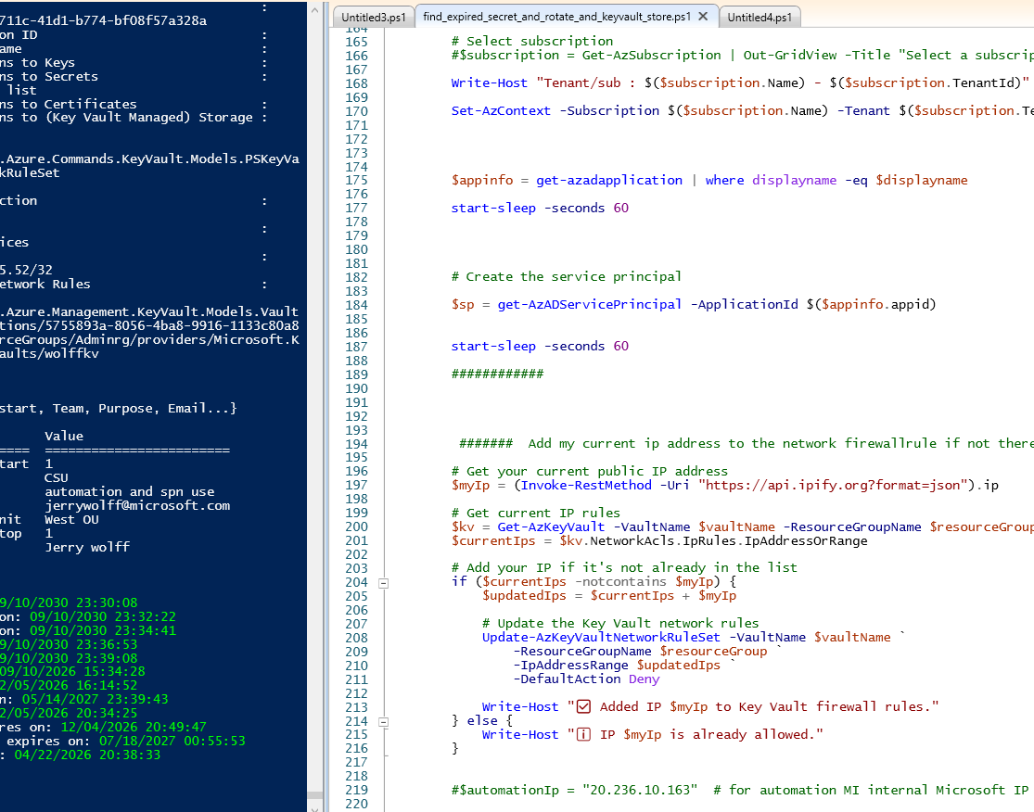
Execution Output Screenshot
Secret Expiration Audit
The script audits secret expiration dates, highlighting expired credentials in red and active ones in green for clarity.
Secret Rotation Process
Expired secrets are removed and replaced with new credentials, ensuring continuous security and access management.
Secure Storage in Azure Key Vault
New credentials are securely stored in Azure Key Vault, enhancing security and centralized secret management.
Automation Validation
Output confirms successful script execution and effective automation, providing visual feedback and validation.
Notes:
This screenshot demonstrates the execution of the PowerShell script in a live environment. It shows the audit of secret expiration dates for various App Registrations, highlighting expired credentials in red and active ones in green. The script then proceeds to remove expired secrets and rotate them by creating new credentials and storing them securely in Azure Key Vault. The output confirms successful operations and provides visual feedback on the automation process, validating the script’s functionality and effectiveness.

